Slide 1
FRESH24MAAL APPLICATION DEV MODULE

Slide 2
Project Intro
E-Commeres platform
We are projecting all the product in custom selection for customer
We cover’s the multiple areas in scale of availability
We are keeping in high availability Eg: 24/7
Backend
Handfull raw product/stock holding
Count and price listing of product/stock that we hold
Frontend
Categories of stocks / product avalibilty and ready to deliver
Billing and Tracking information
Remarketing and offering

Slide 3

A Prefixed Goal with which we are working for
As we are the army working with best solutions we planed, We can achive the goal in next 3 years and we stands as one of best seller in market.

Slide 4
Project FrontEnd / Technicals
WEB co App Interface
Web co App interface was able to mould as per device and require no installation
Able to reach Desktop and Mobile uses
Rich image and description about product can be explained
4. Faster and multiple product can be shown on single window
5. No need of version control and device compact format required
Direct App Interface
Direct App interface is platform different from web interface and require installation of user device
Able to reach Mobile users only
Compressed image and less description about product can be explained
4. Little bit slower than web and multiple products can't shown in single window
5. Need of version control and device compact format required

Slide 5
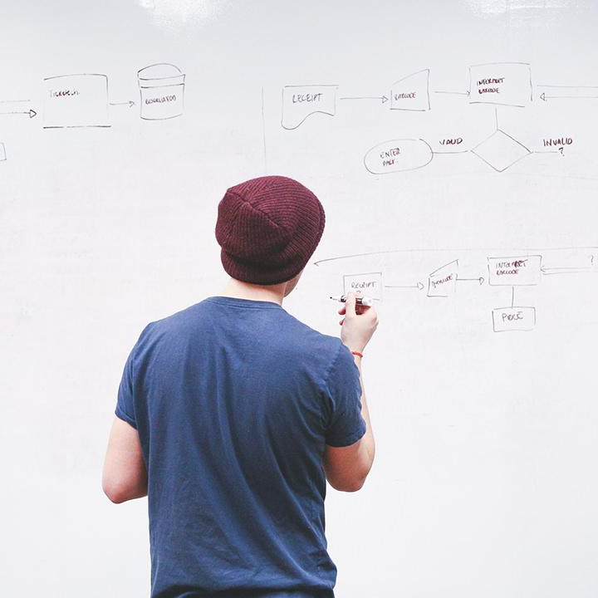
Startup module
Need to setup a module to achive the project interface that should go on live within agive time

Slide 6
AGILE methodology
1
Design | Integration and Testing | Production

Slide 7
practice that promotes continuous iteration of development and testing throughout the software development lifecycle of the project.

Slide 8
Roles
Project Owner / Client
Scrum Master
Developers and Application Tester/QA

Slide 9
CONCEPT JIRA
Tracking product developed by using Sprint

Slide 10
OUR CONTENT
Epic
An Epic can be defined as a big chunk of work that has one common objective. It could be a feature, customer request or business requirement..
Story point
A story point is a metric used in project management and development to determine (or estimate) the difficulty of implementing a given story.

Slide 11
Agile Team
Development
Here the Story point are asigned to Dev team and we stage the requirment that need to achieve the story points.
Testing
Dev team achieved story point would be assigned to Test/QA team to achieve the production level .
Production deployment
As the DEV and Test/QA team processed the story point sucessfully, project owner should give the acceptance to go live.

Slide 12

Reports and Assessment Meetup
As Sprint scheduled for the project, Reports and Assessment meet up could resolve the issues and complexity of project on both sides

Slide 13
DevOps methodology
2
Infrastructure as a service (IaaS)
Continuous Integration Continuous Delivery (CI & CD)

Slide 14
Continues Development and Continues Deployment
Devlopment
Testing
Production

Slide 15
DevOps Automation
 | Sprint 1 Servers Require | Sprint 2 Servers Require | Sprint 3 Servers Require
Devoplement | 3 | 5 | 7
Testing | 2 | 2 | 2
Production | 2 | 2 | 2

Slide 16
Cloud Services
Servers Location
High Availability Zone

Slide 17
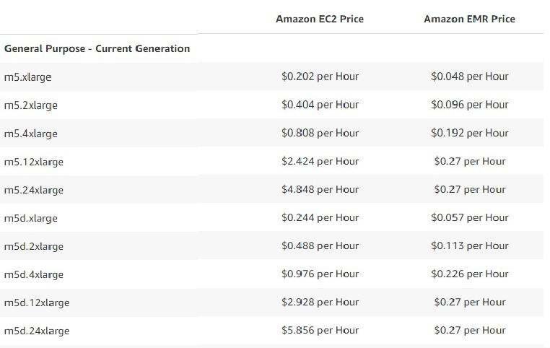
Servers and Price details

Slide 18
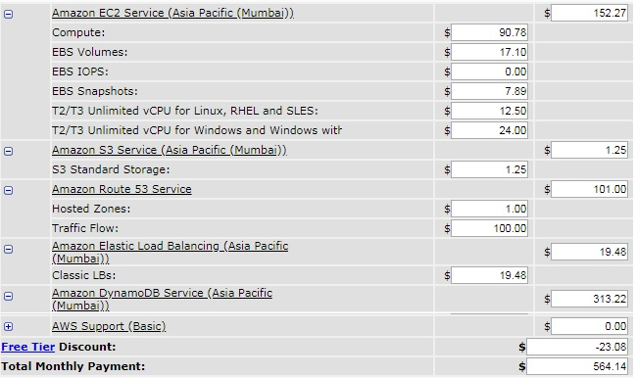
Estimation price for month (Developer and Test )

Slide 19
$550 to $700
$200 to $350
$350
Servers of Dev team for a month
Servers of Test/QA for a month
Production Servers for a month

Slide 20
http://www.fresh24maal.com
DESKTOP co APP
Based on sprints moving on, we will successfully launch the interface Through Jenkins CI & CD method.

Slide 21
Playstore
ANDROID PROJECT
After the few sucessful Sprints approved then Android app integration gets started with version control system.

Slide 22
iPHONE PROJECT
Simultaneously interface integration done
Apple store

Slide 23
Conclusion
first
second
Third

Slide 24

Want’s the impact?

Slide 25
THANKS!
Any questions?
-Sharath

